Slide 1
Online stock predictor
System architecture and components

Slide 2

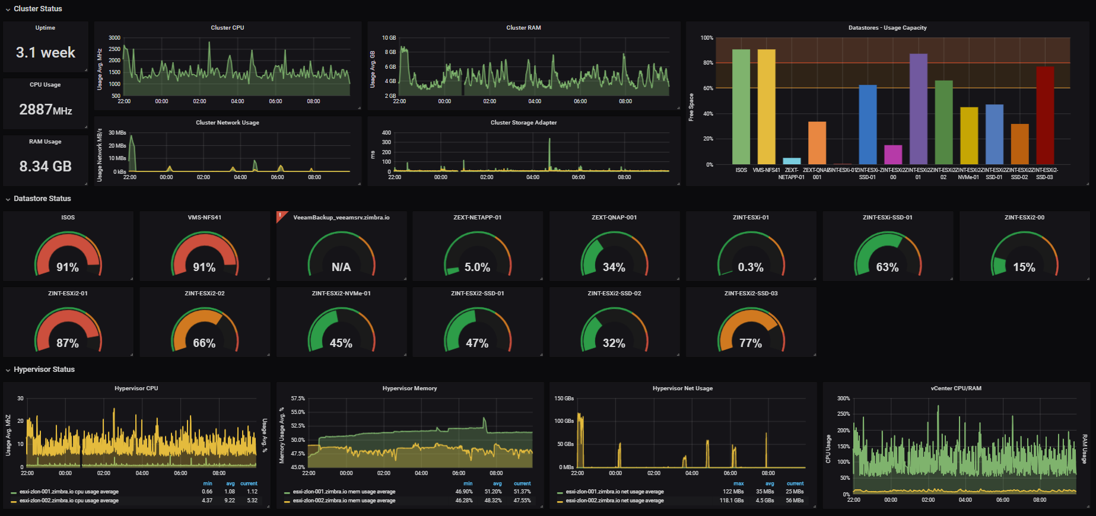
System architecture
DataReader
yfinance
TestDataRead
ModelInferrer
TrainDataRead
ModelTrainer
dbSe
RNN
Capsule Network
...
tbTrain
tbInfer
yyyy.mm.dd.pickle
Utils
(pre-process & plotting)

Slide 3
Training (and Testing) Phase
Data
Data is downloaded by TrainDataRead module each evening after 6 PM for that day (and any previous day not present) for all stocks – can be a cron job. Data is saved to tbTrain table
Training
ModelTrainer reads last 30 days data from tbTrain. It trains the model and saves to DB as a YYYYMMDD.pickle file.
Currently inference engine will use latest ML model. Later, we would like to use the “best” performing model based on some performance criteria
per minute
yfinance
TrainDataRead
ModelTrainer
dbSe
tbTrain
YYYYMMDD.pickle

Slide 4
Inference Phase
ModelInferrer reads the latest model from DB
TestDataRead reads data every minute in variable “real(t)”
It writes real(t) along with previous prediction pred(t) and timestamp to tbInfer
ModelInferrer infer next minute prediction called “pred(t+1)”
Script wait for 1 minute
DataReader
yfinance
TestDataRead
ModelInferrer
yyyy.mm.dd.pickle
dbSe
tbInfer

Slide 5
Visualization Phase
Graphana reads data from tbInfer and shows the results in dashboard
dbSe
tbInfer

Slide 6
dashboard
Drop-down (Single selection) list of market places (crypto, se, us)
Line graph of real-vs-predicted stock values
Drop-down (Single or multi-selection) list of stocks in above market, for which we want to see the inference
News related to selected stock
Line graph of confidence of prediction (Tentative)
Line graph of Error (same resolution as above graph)
No, of stocks to buy/sell
Price (default is current price)
List of current best performing stocks (as per ML prediction)

